Slide 1
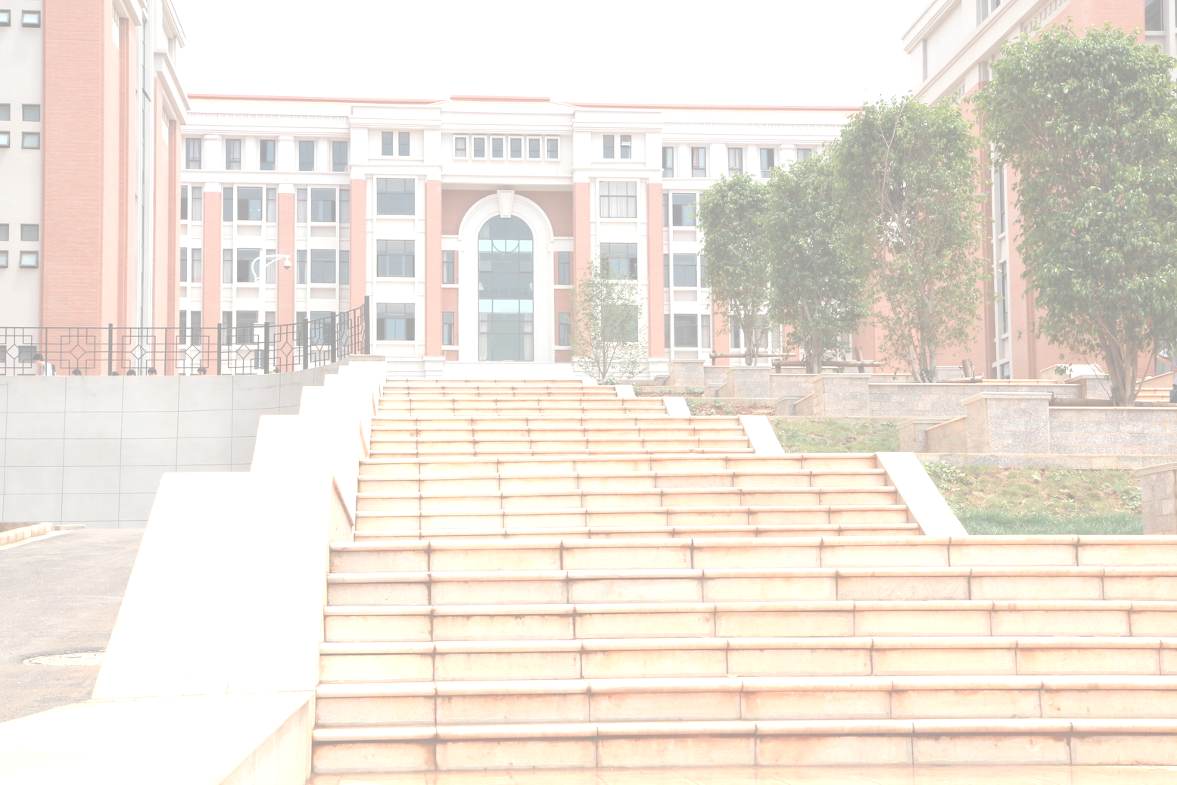

Software Engineering

Slide 2
Software Requirements
Chapter 6

Slide 3

Objectives
To introduce the concepts of user and system requirements
To describe functional and non-functional requirements
To explain how software requirements may be organised in a requirements document

Slide 4
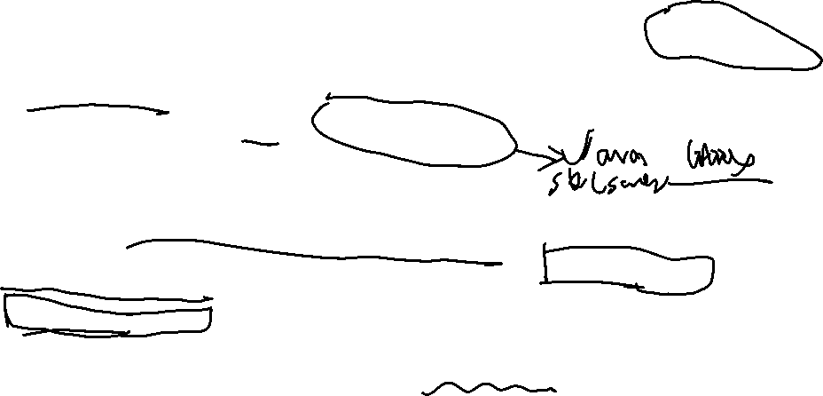
Requirements engineering
The process of establishing the services (Functions) that the customer requires from a system and the constraints under which it operates and is developed.
The requirements themselves are the descriptions of the system functions and constraints that are generated during the requirements engineering process.

Slide 5
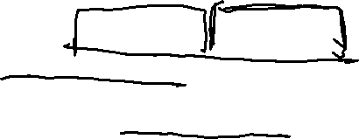
What is a requirement?
It may range from a high-level abstract statement of a function or of a system constraint to a detailed mathematical functional specification.
This is inevitable as requirements may serve a dual function
  May be the basis for a bid for a contract - therefore must be open to interpretation;
  May be the basis for the contract itself - therefore must be defined in detail;
  Both these statements may be called requirements.

Slide 6
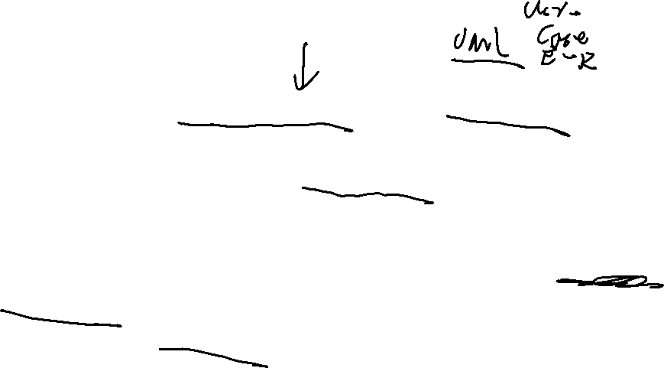
Types of requirement
User requirements
  Statements in natural language plus diagrams of the functions the system provides and its operational constraints. Written for customers.
System requirements
  A structured document setting out detailed descriptions of the system’s functions, services and operational constraints.

Slide 7
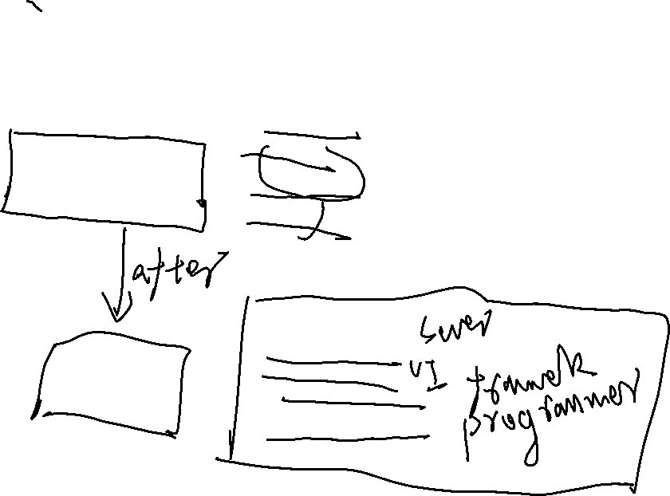
Requirements readers
End-users
User
Contractor
managers
requir
ements
Customers
System engineers
S
ystem
Client engineers
requir
ements
System architects
Softw
ar
e dev
elopers

Slide 8

6.1 Functional and non-functional requirements
Functional requirements
  Statements of functions the system should provide, how the system should react to particular inputs and how the system should behave in particular situations.
Non-functional requirements
  constraints on the functions offered by the system such as timing constraints, constraints on the development process, standards, latency, quality, capecity, etc.

Slide 9
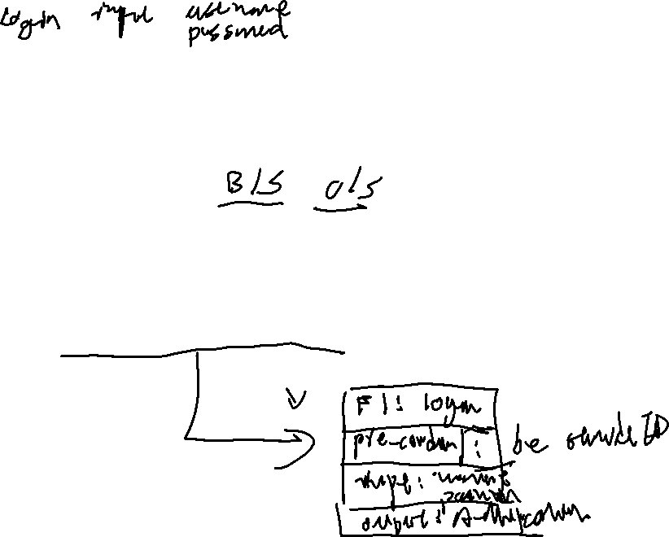
6.1.1 Functional requirements
Describe functionality or system services.
Depend on the type of software, expected users and the type of system where the software is used.
Functional user requirements may be high-level statements of what the system should do but functional system requirements should describe the system services in detail.

Slide 10
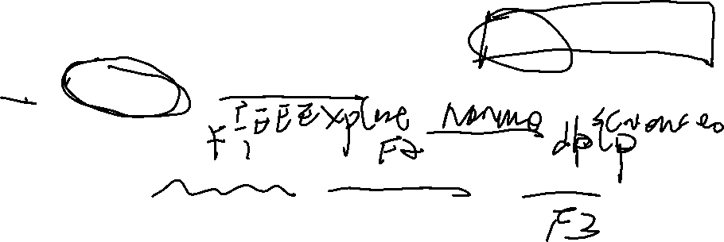
The LIBSYS system
A library system that provides a single interface to a number of databases of articles in different libraries.
Users can search for, download and print these articles for personal study.

Slide 11
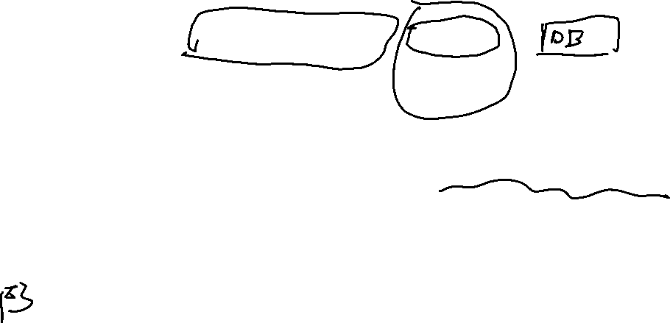
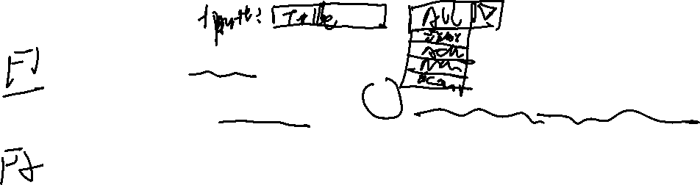
Examples of functional requirements
The user shall be able to search either all of the initial set of databases or select a subset from it.
The system shall provide appropriate viewers for the user to read documents in the document store.
Every order shall be allocated a unique identifier (ORDER_ID) which the user shall be able to copy to the account’s permanent storage area.

Slide 12

Requirements imprecision
Problems arise when requirements are not precisely stated.
Ambiguous requirements may be interpreted in different ways by developers and users.
Consider the term ‘appropriate viewers’
  User intention - special purpose viewer for each different document type;
  Developer interpretation - Provide a text viewer that shows the contents of the document.

Slide 13
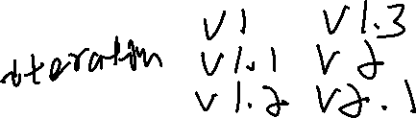
Requirements completeness and consistency
In principle, requirements should be both complete and consistent.
Complete
  They should include descriptions of all facilities required.
Consistent
  There should be no conflicts or contradictions in the descriptions of the system facilities.
In practice, it is impossible to produce a complete and consistent requirements document.

Slide 14
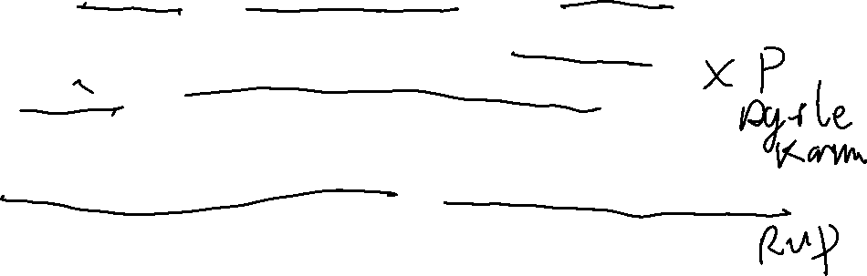
6.1.2 Non-functional requirements
These define system properties and constraints e.g. reliability, response time and storage requirements. Constraints are I/O device capability, system representations, etc.
Process requirements may also be specified programming language or development method.
Non-functional requirements may be more critical than functional requirements. If these are not met, the system is useless.

Slide 15
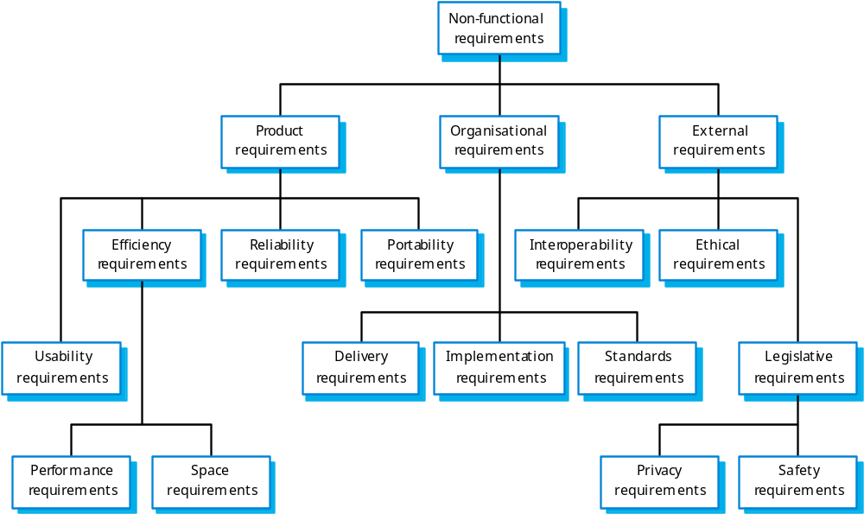
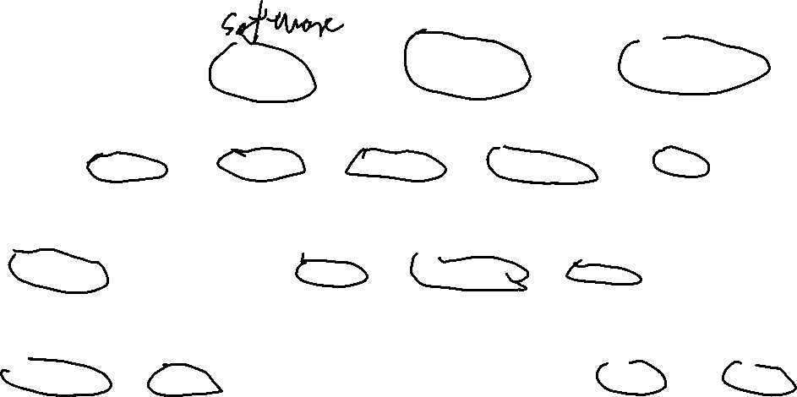
Non-functional requirement types

Slide 16
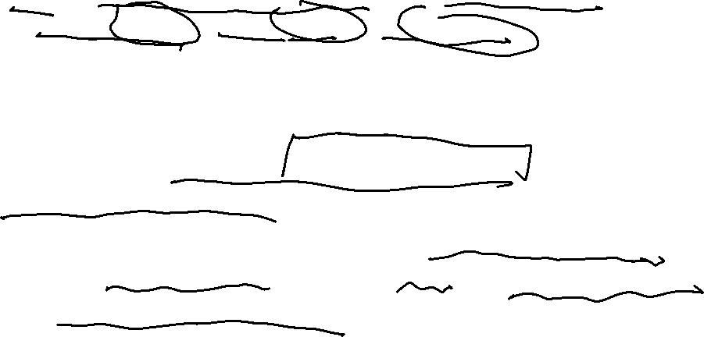
Non-functional requirements examples
Product requirement
  8.1 The user interface for LIBSYS shall be implemented as simple HTML without frames or Java applets.
Organisational requirement
  9.3.2 The system development process and deliverable documents shall conform to the process and deliverables defined in the standard XYZCo-SP-STAN-95.
External requirement
  7.6.5 The system shall not disclose any personal information about customers apart from their name and reference number to the operators of the system.

Slide 17
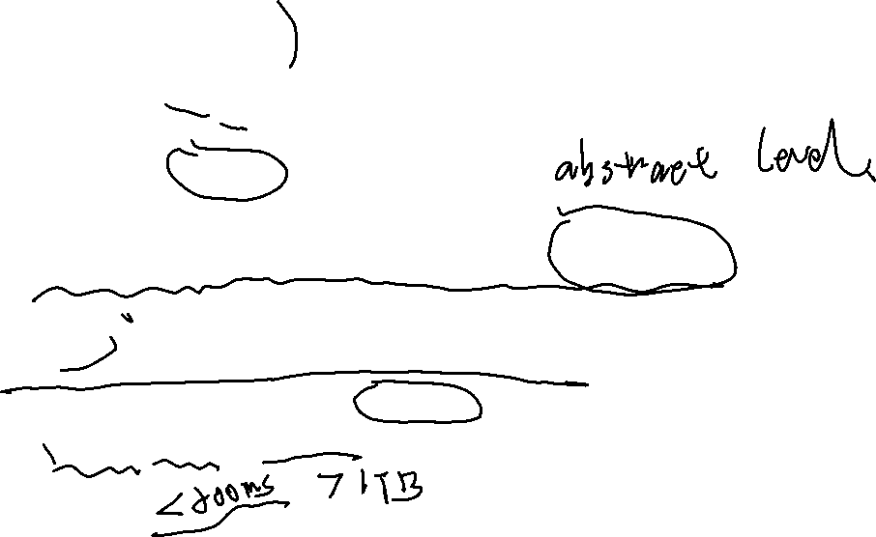
Goals and requirements
Non-functional requirements may be very difficult to state precisely and imprecise requirements may be difficult to verify.
Goal
  A general intention of the user such as ease of use.
Verifiable non-functional requirement
  A statement using some measure that can be objectively tested. (latency, capecity, etc)

Slide 18
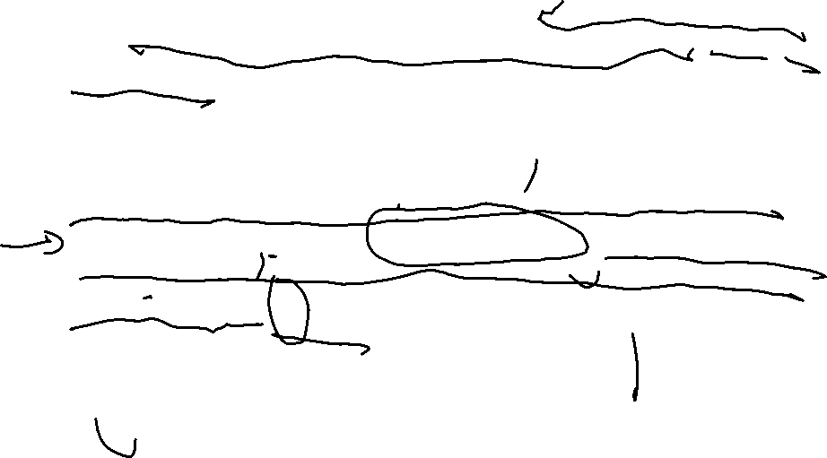
Examples
A system goal
  The system should be easy to use by experienced controllers and should be organised in such a way that user errors are minimised.
A verifiable non-functional requirement
  Experienced controllers shall be able to use all the system functions after a total of 2 hours training. After this training, the average number of errors made by experienced users shall not exceed 2 per day.

Slide 19
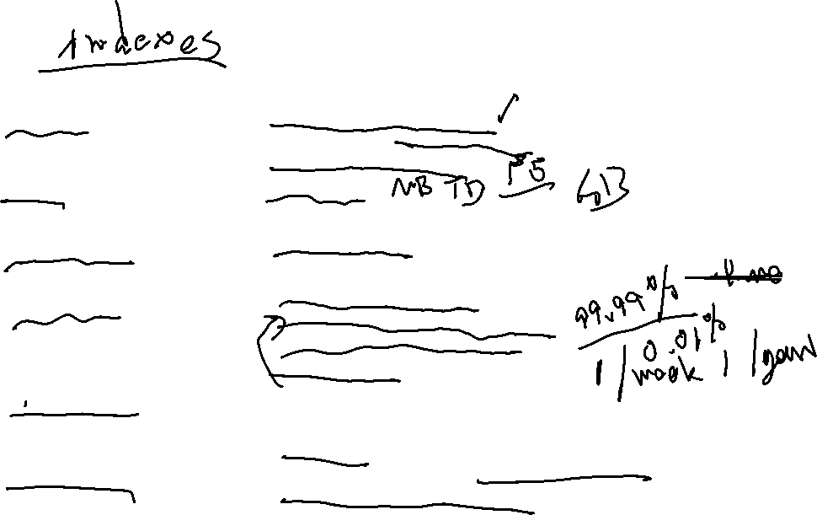
Requirements measures
Pr
op
er
t
y
M
ea
su
r
e
S
p
e
ed
P
r
o
ce
ss
e
d
t
ra
ns
ac
t
i
o
n
s
/
se
co
n
d
Us
er
/
Ev
e
nt r
e
s
p
o
ns
e
t
i
m
e
S
c
r
ee
n
r
e
f
r
e
sh
t
im
e
S
iz
e
M
B
y
te
s
N
u
mb
er
o
f
R
O
M
ch
i
p
s
Ea
s
e
o
f us
e
T
r
ai
n
i
n
g
t
i
m
e
N
u
mb
er
o
f h
el
p
f
r
a
m
e
s
R
e
li
a
bi
l
i
t
y
M
e
an ti
m
e
t
o f
ail
ur
e
P
r
o
b
a
b
i
li
t
y
of
u
n
a
v
ai
l
ab
i
li
t
y
R
a
te
of
f
a
il
ur
e
o
ccu
rr
en
c
e
A
va
i
la
b
i
l
it
y
R
o
b
us
t
n
e
ss
Ti
me
t
o
r
e
s
ta
r
t
af
t
e
r
f
ai
l
u
r
e
P
e
r
ce
n
ta
g
e
o
f
e
ve
n
t
s c
au
si
n
g f
ai
l
u
r
e
P
r
o
b
a
b
i
li
t
y
of
d
a
ta
c
o
r
r
u
p
t
i
o
n
o
n
f
a
il
u
r
e
P
o
r
t
a
bi
l
i
t
y
P
e
r
ce
n
ta
g
e
o
f
t
a
r
ge
t d
epe
n
d
e
n
t s
ta
t
e
m
e
n
t
s
N
u
mb
er
o
f
t
a
r
g
et
s
y
s
t
e
m
s

Slide 20
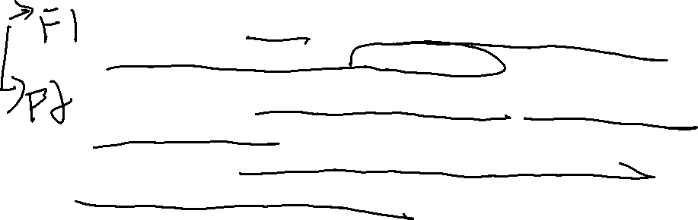
Requirements interaction
Conflicts between different non-functional requirements are common in complex systems.
Spacecraft system
  To minimise weight, the number of separate chips in the system should be minimised.
  To minimise power consumption, lower power chips should be used.
  However, using low power chips may mean that more chips have to be used. Which is the most critical requirement?

Slide 21
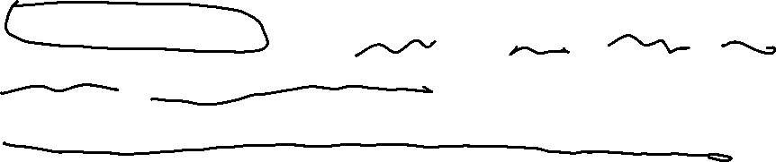
6.2 User requirements
Should describe functional and non-functional requirements in such a way that they are understandable by users who don’t have detailed technical knowledge.
User requirements are defined using natural language, tables and diagrams as these can be understood by all users.

Slide 22
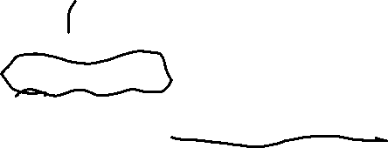
Problems with natural language
Lack of clarity
  Precision is difficult without making the document difficult to read.
Requirements confusion
  Functional and non-functional requirements tend to be mixed-up.
Requirements amalgamation
  Several different requirements may be expressed together.

Slide 23
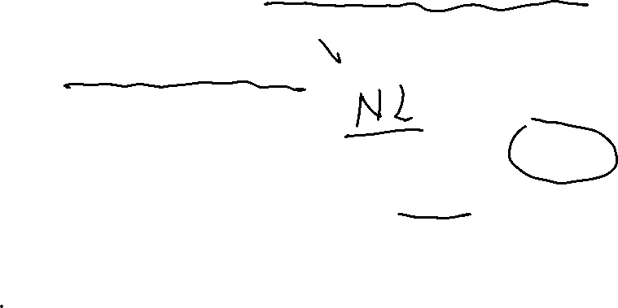
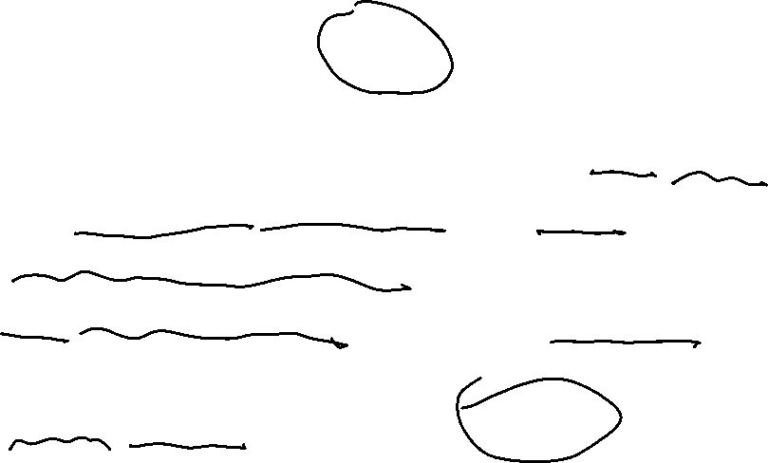
Guidelines : User requirements
Invent a standard format and use it for all requirements.
Use language in a consistent way. Use “shall” for mandatory requirements, “should” for desirable requirements.
Use text highlighting to identify key parts of the requirement.
Avoid the use of computer jargon.

Slide 24
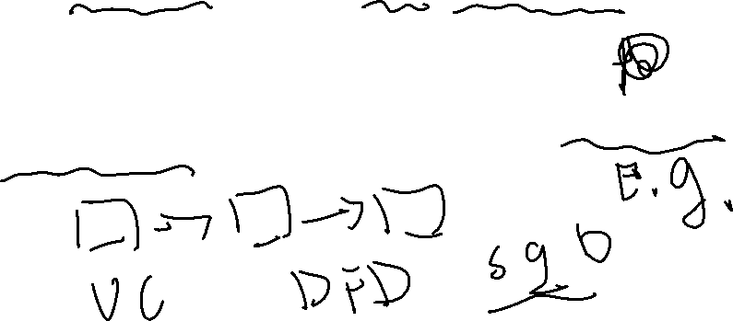
System requirements
More detailed specifications of system functions, services and constraints than user requirements.
They are intended to be a basis for designing the system.
System requirements may be defined or illustrated using system models discussed in Chapter 8.

Slide 25
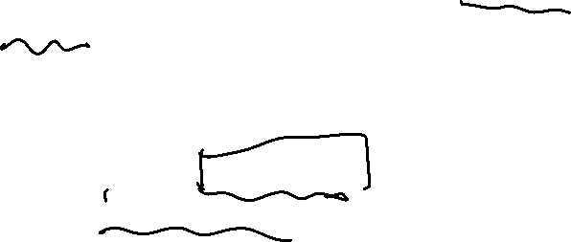
Requirements and design
In principle, requirements should state what the system should do and the design should describe how it does this.
In practice, requirements and design are inseparable
  A system architecture may be designed to structure the requirements;
  The system may inter-operate with other systems that generate design requirements;

Slide 26
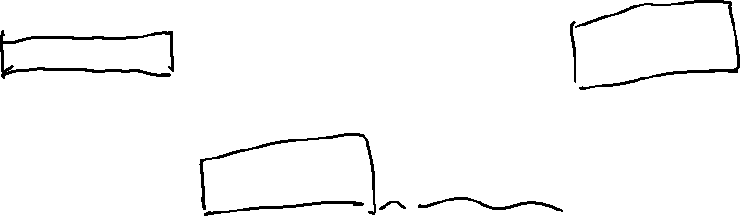
Problems with NL specification
Ambiguity
  The readers and writers of the requirement must interpret the same words in the same way. NL is naturally ambiguous so this is very difficult.
Over-flexibility
  The same thing may be said in a number of different ways in the specification.
Lack of modularisation
  NL structures are inadequate to structure system requirements.

Slide 27
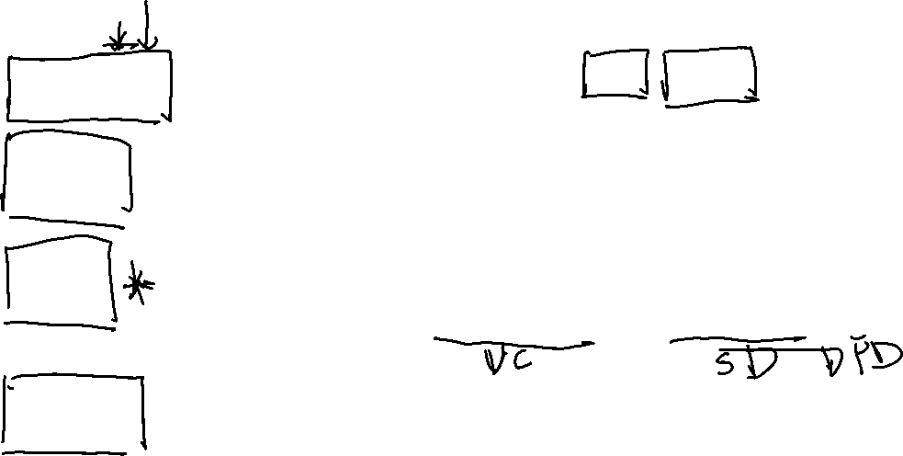
Alternatives to NL specification
No
t
at
i
o
n
De
s
cr
ip
t
i
o
n
St
ru
c
tu
r
ed
na
t
u
r
a
l
T
hi
s
a
pproa
c
h
dep
e
nds
on
de
fi
n
i
ng
s
t
a
ndard
f
or
ms
o
r
t
e
m
p
l
a
t
e
s
t
o
exp
r
es
s
t
he
l
anguage
r
equ
i
r
e
m
e
n
t
s
spec
ifi
ca
ti
on.
De
si
gn
T
hi
s
a
pproa
c
h
u
s
es a
la
nguage
li
ke
a
prog
r
a
mmi
ng
l
angu
a
ge
bu
t
w
i
th
m
o
r
e ab
st
r
a
c
t
de
s
cr
i
p
ti
on
f
ea
t
u
r
es
t
o
s
pec
if
y
t
he
requ
ir
e
m
en
ts
by
def
i
n
i
ng
an op
e
ra
ti
ona
l m
ode
l
o
f
t
h
e
sy
st
e
m
.
l
anguage
s
T
hi
s
a
pproa
c
h
i
s
no
t
now
w
i
de
l
y
used
a
lt
hough
it
c
an
b
e
us
e
fu
l
fo
r
in
te
r
f
ace
sp
e
c
i
f
i
c
at
ion
s
.
G
r
aph
i
ca
l
A
graph
ic
a
l
l
anguag
e
, supp
l
e
m
en
t
ed
by
t
ex
t
anno
t
a
ti
ons
i
s
used
t
o de
fi
ne
t
he
no
t
a
ti
ons
f
unc
ti
ona
l
r
equ
ir
e
m
en
t
s
fo
r
th
e
s
ys
t
e
m
.
An
ea
rl
y exa
m
p
l
e
o
f
s
uch
a
g
r
aph
i
ca
l
l
anguage
wa
s
S
AD
T
.
Now
,
u
s
e
-
cas
e
de
s
c
r
ip
ti
on
s
and
s
equence d
i
ag
r
a
m
s
a
r
e
co
mm
on
l
y u
s
ed
.
M
at
he
m
a
ti
ca
l
T
hese
a
r
e no
ta
t
i
on
s
ba
s
ed on
m
a
t
he
m
a
ti
c
a
l concep
ts
s
uch
a
s f
i
n
it
e
-
s
t
a
t
e
m
ach
i
ne
s
o
r
sp
e
c
i
f
i
c
at
ion
s
s
et
s
.
T
hese
una
m
b
i
guous
spe
ci
f
i
ca
ti
on
s
r
educe
t
he
argu
m
en
ts
b
e
t
w
een
c
us
t
o
m
e
r
and
con
tr
ac
t
o
r
abou
t
sy
st
e
m
f
unc
ti
ona
lit
y.
Howeve
r
,
m
os
t
cus
t
o
m
e
r
s
don
’
t
unde
r
s
t
and
f
or
m
a
l
spe
ci
f
i
ca
ti
on
s
and a
r
e
r
e
l
uc
t
an
t t
o a
c
cep
t
it
as
a
s
ys
t
e
m
con
tr
ac
t
.

Slide 28
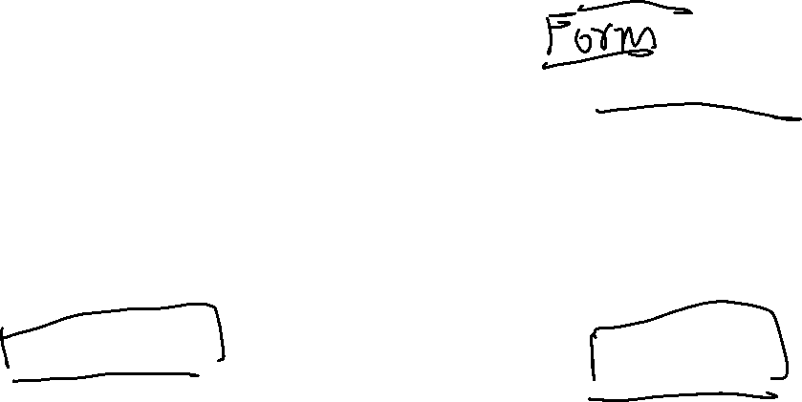
Structured language specifications
The freedom of the requirements writer is limited by a predefined template for requirements.
All requirements are written in a standard way.
The terminology used in the description may be limited.
The advantage is that the most of the expressiveness of natural language is maintained but a degree of uniformity is imposed on the specification.

Slide 29
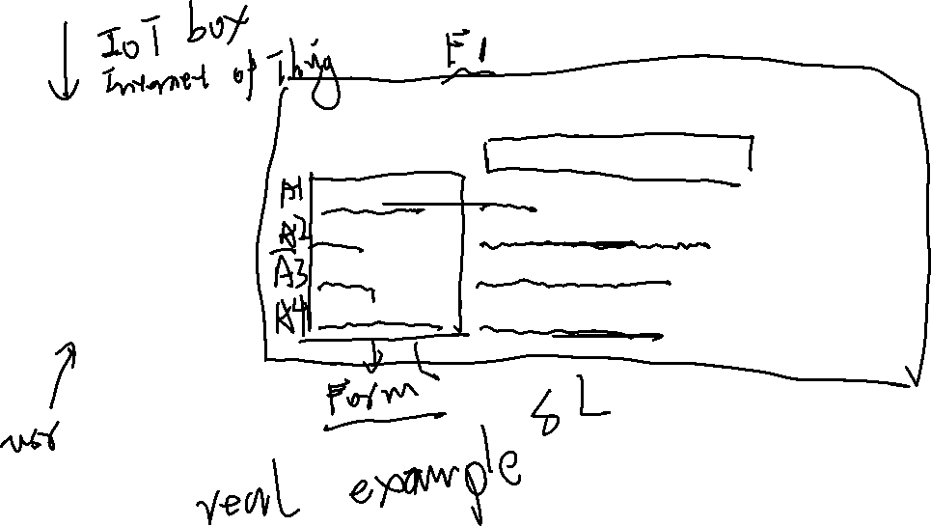
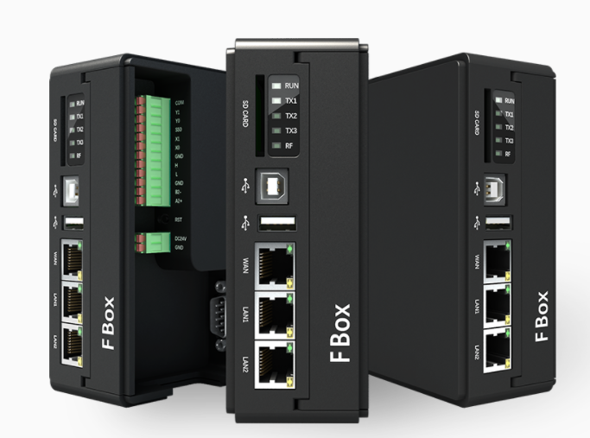
e.g. Structred Language
Functional Requirement
F1- Login to the IoT BOX
pre-condition | the url
Input | verification information
output | status of Verification
post-condition | redirect to main page

Slide 30
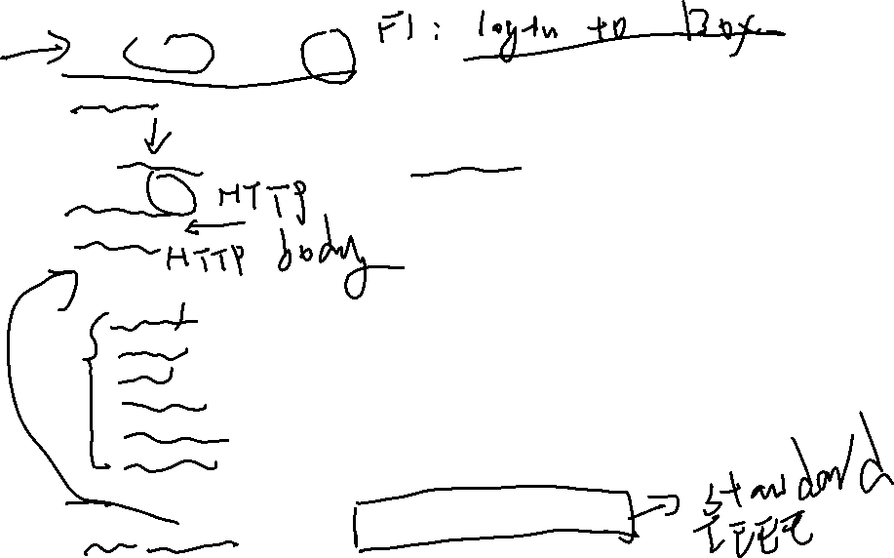
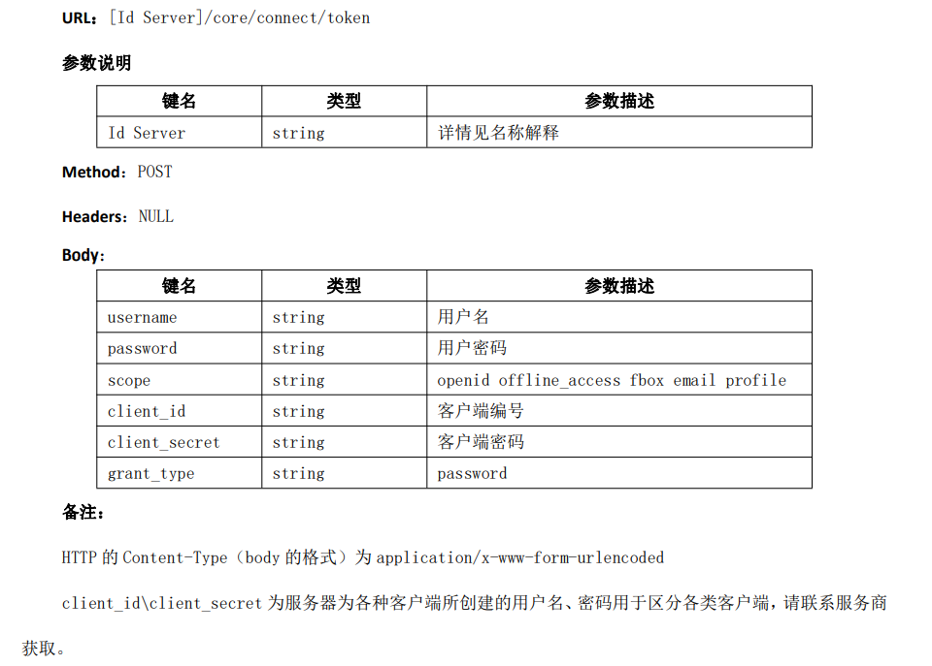
e.g. Structred Language/ Design

Slide 31
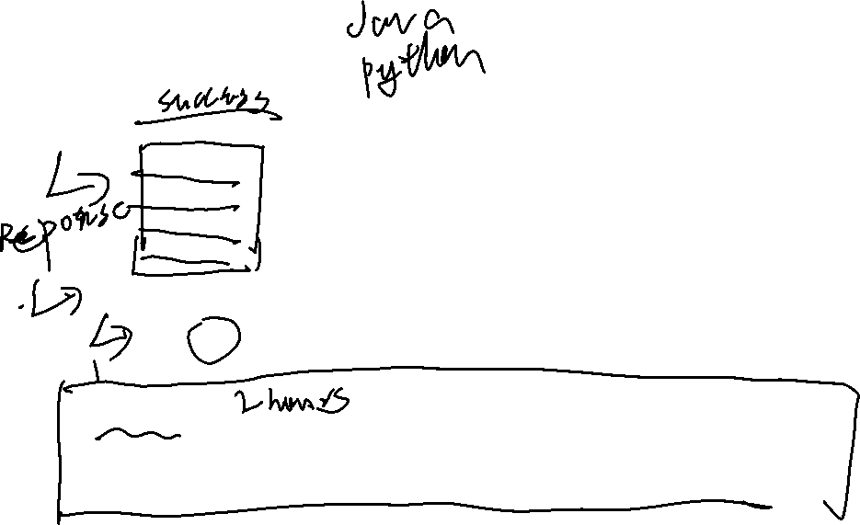
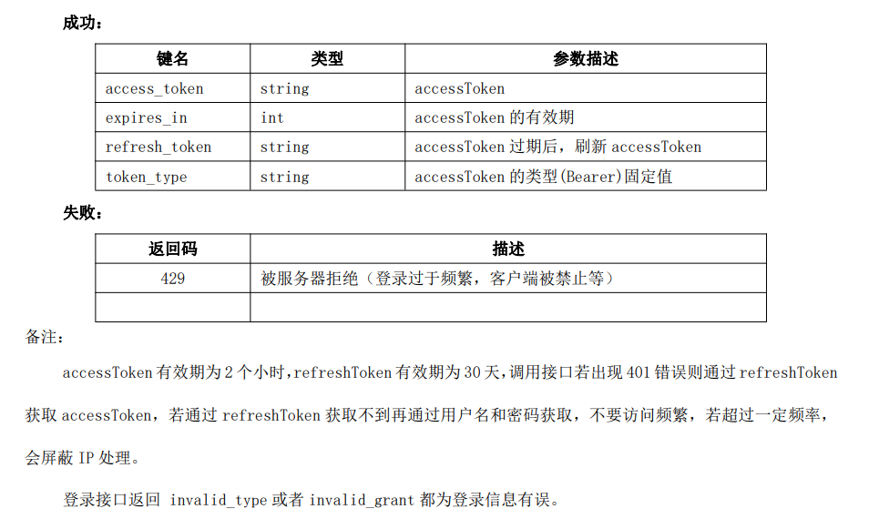

Slide 32
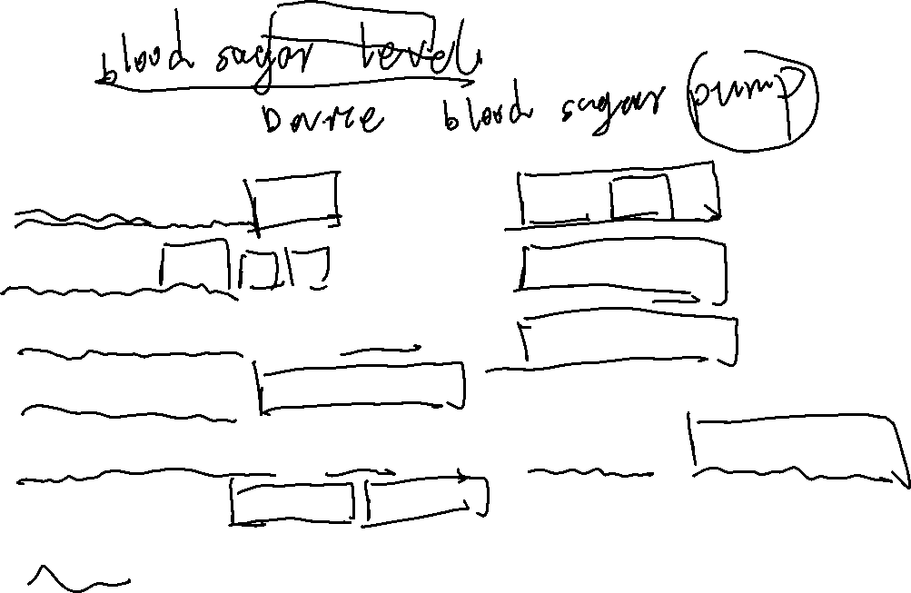
Tabular specification
C
o
nd
i
t
i
o
n
A
ct
i
o
n
S
u
g
a
r
le
v
e
l
f
a
ll
i
n
g (
r
2
<
r
1
)
C
om
p
D
o
se
=
0
S
u
g
a
r
le
v
e
l
s
ta
b
le
(
r2
=
r
1
)
C
om
p
D
o
se
=
0
S
u
g
a
r
le
v
e
l
i
n
c
r
ea
s
i
n
g
an
d r
ate
o
f
C
om
p
D
o
se
=
0
i
n
c
r
ea
s
e
dec
r
ea
si
n
g (
(
r2
-
r
1
)
<
(
r
1-
r
0
)
)
S
u
g
a
r
le
v
e
l
i
n
c
r
ea
s
i
n
g
an
d r
ate
o
f
C
om
p
D
o
se
=
r
o
u
n
d (
(
r
2
-r
1
)
/
4
)
i
n
c
r
ea
s
e
s
t
a
b
le
or
i
n
c
r
ea
s
i
n
g
.
(
(r
2
-r
1
)
>
I
f
r
o
u
n
de
d r
e
s
u
l
t
=
0
t
h
en
(
r
1
-
r0
)
)
C
om
p
D
o
se
=
M
in
im
u
mD
o
s
e

Slide 33
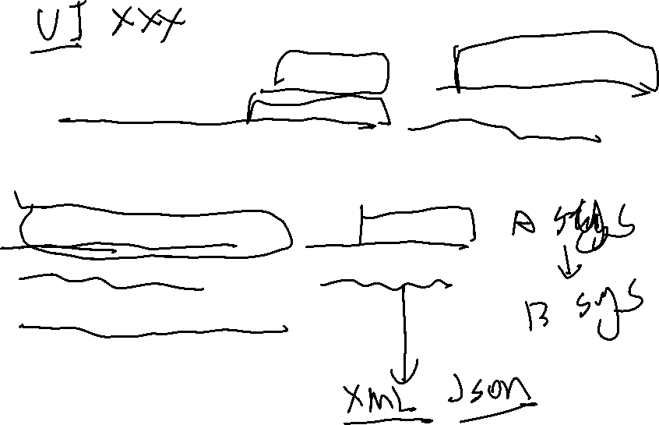
6.4 Interface specification
Most systems must operate with other systems and the operating interfaces must be specified as part of the requirements.
Three types of interface may have to be defined
  Procedural interfaces; e.g. Functions
  Data structures that are exchanged;
  Data representations.
Formal notations are an effective technique for interface specification.

Slide 34
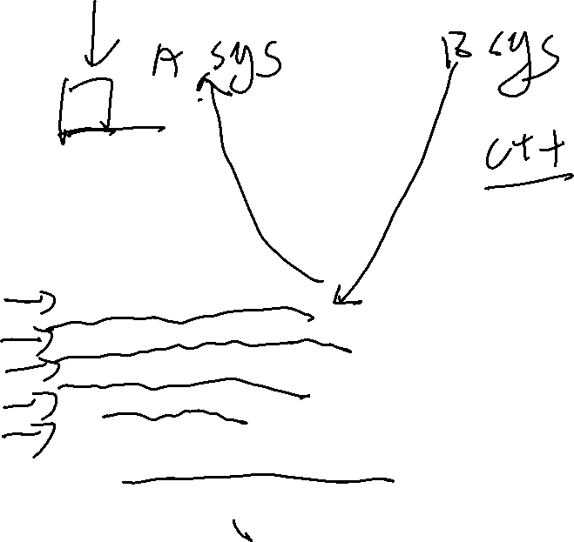
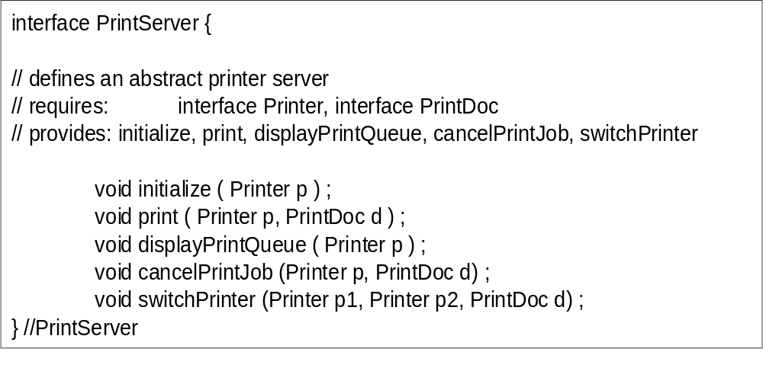
Java interface description

Slide 35
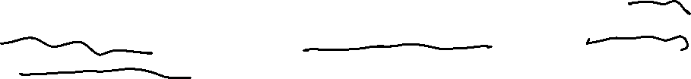
6.5 The requirements document
The requirements document is the official statement of what is required of the system developers.
Should include both a definition of user requirements and a specification of the system requirements.
It is NOT a design document. As far as possible, it should set of WHAT the system should do rather than HOW it should do it

Slide 36
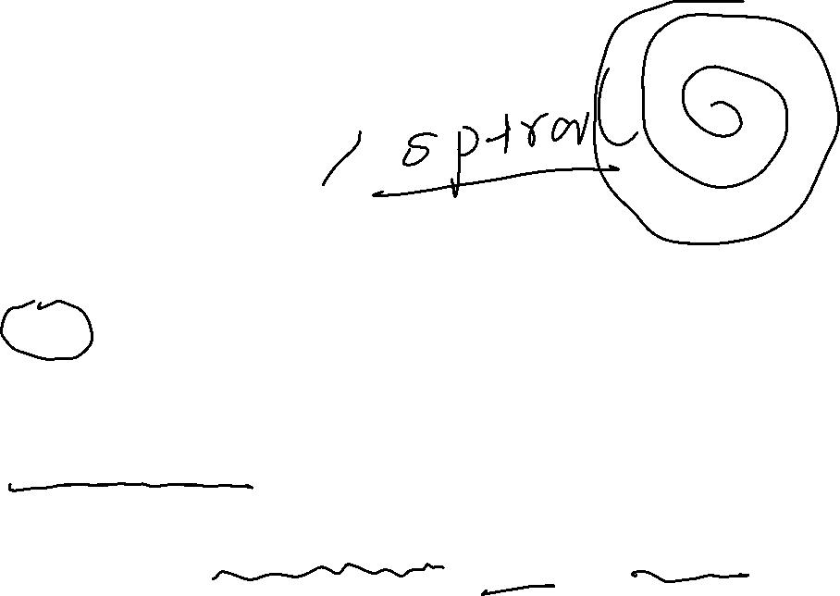

Key points
Requirements set out what the system should do and define constraints on its operation and implementation.
Functional requirements set out services the system shall provide.
Non-functional requirements constrain the system being developed.
User requirements are high-level statements of what the system should do. User requirements should be written using natural language, tables and diagrams.

